Slide 1
Day 6 - Encoding and Sending Formatted Text
Unit 1 Chapter 1 - Lesson 7

Slide 2

Quiz time!
5pts
Grade Quiz
Grade Code.org Progress

Slide 3

Reminders
information sent by a computer is encoded in bits, we need protocols to help us interpret these bits as meaningful information
In previous lessons we learned how to use the binary number system to allow us to represent numbers in bits
How do we send text?

Slide 4
ASCII- Born 1963
American Standard Code for Information Interchange (ASCII)
number-to-text encoding scheme used in computers and on the Internet
numerical representation of a character such as 'a' or '@' or an action of some sort
This protocol is 7 bits long and so can encode 128 different symbols, however the byte system is still used to send. 0 at front of 7 bits.
Originally the encoding was designed for older printers and so the codes associated with the numbers 0-31 were designated as "control codes" which instruct the printer to perform certain actions. These codes are now largely out of use.

Slide 5
ASCII
Codes 32-126, however, contain many of the most commonly used symbols you use on the internet, including the lowercase and capital letters, the numbers 0-9, and most commonly-used punctuation marks
Also used to represent all of the text formatting we use to add variety and emphasis to "plain-text" documents
The ability to represent formatting using only ASCII symbols is the result of cleverly designed protocols

Slide 6
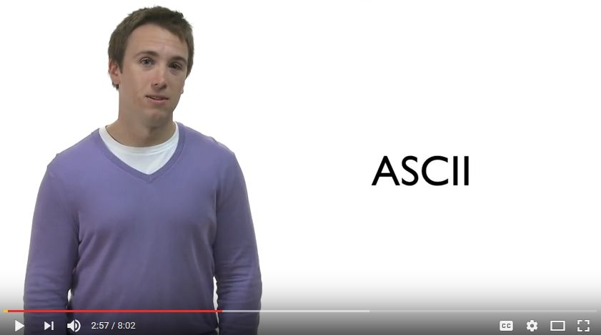
ASCII - Video

Slide 7
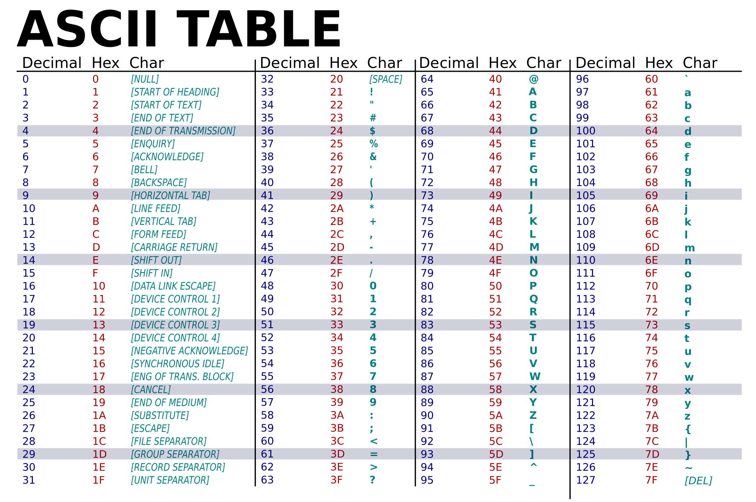

Slide 8
Casey! - Conversion Example
My Example
Casey!
01000011 (67), 0110000 (97) What are next letters?

Slide 9
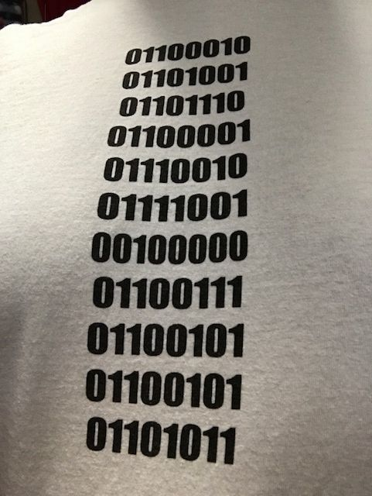
Coach B
T-Shirt

Slide 10
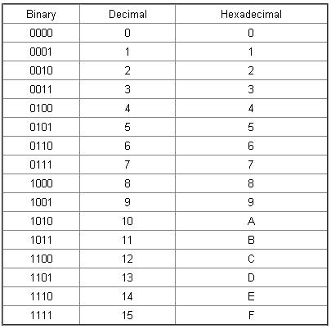
Hexadecimal
In mathematics and computing, hexadecimal (also base 16, or hex) is a positional numeral system with base of 16
It uses sixteen distinct symbols, most often the symbols 0–9 to represent values zero to nine, and A, B, C, D, E, F to represent values ten to fifteen

Slide 11
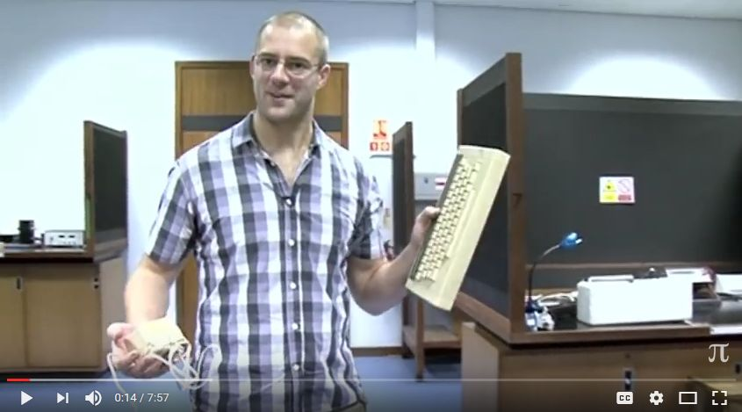
Hexadecimal Conversion Video

Slide 13
Casey! - Conversion Example- Part 2
My Hexadecimal Example
Casey! = 43, 61, 73, 65, 79, 21

Slide 14
Activity
Right your first and last name in Hexadecimal
Don’t forget capital letters
Don’t forget space between first and last name

Slide 15
Activity
Right your first and last name in binary
Don’t forget capital letters
Don’t forget space between first and last name

Slide 16
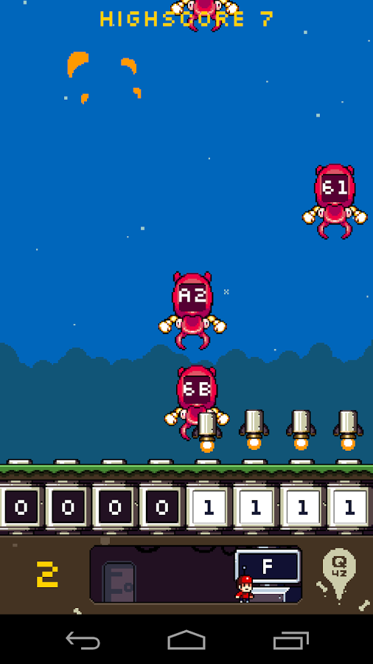
Website Game
Flippy Bit and the Attack of the Attack of the Hexadecimals from Base 16
2 Year Old Playing the Game!

Slide 17
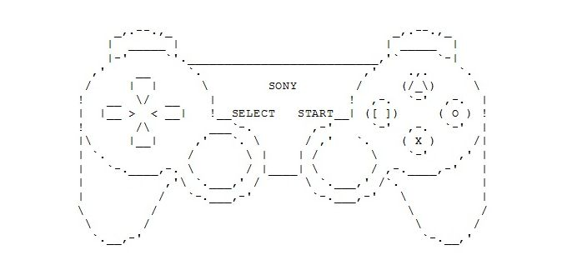
ASCII- Fun Side

Slide 18
ASCII- Art
ASCII art is a graphic design technique that uses the 95 ASCII printable (from a total of 128) characters
ASCII art can be created with any text editor
One of the main reasons ASCII art was born was because early printers often lacked graphics ability and thus characters were used in place of graphic marks
ASCII art was also used in early e-mail when images could not be embedded
This form of art dates way back…

Slide 19
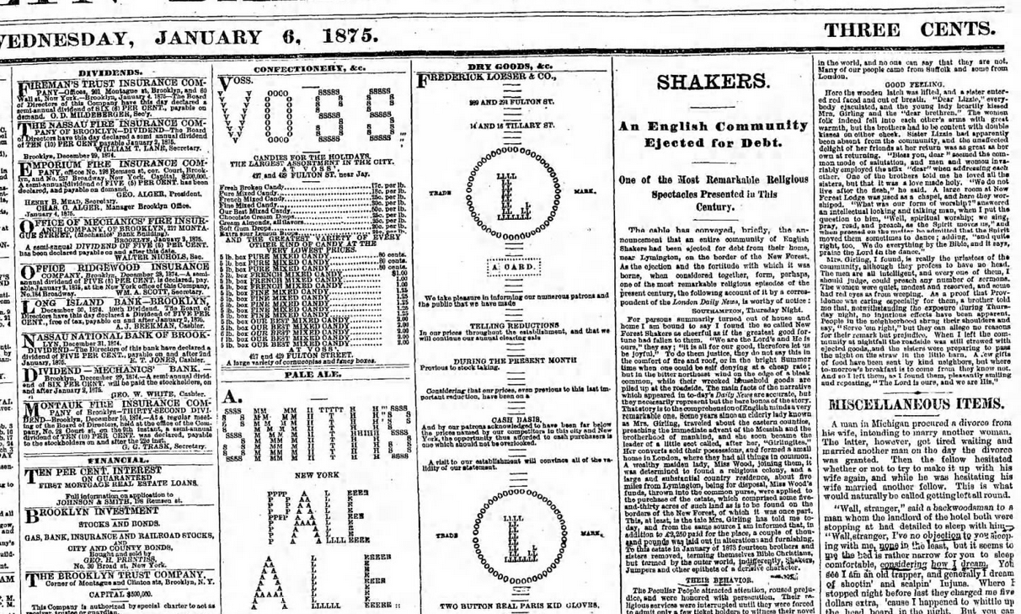

Slide 20
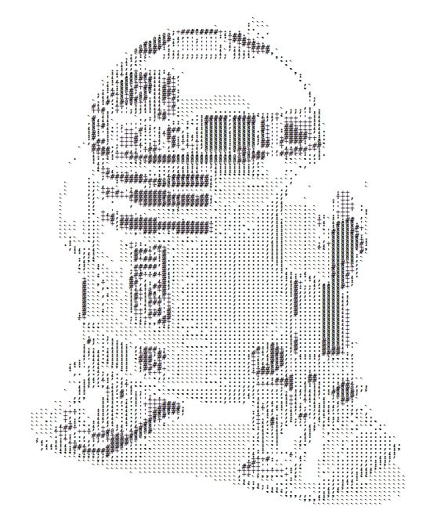

ASCII Art

Slide 21
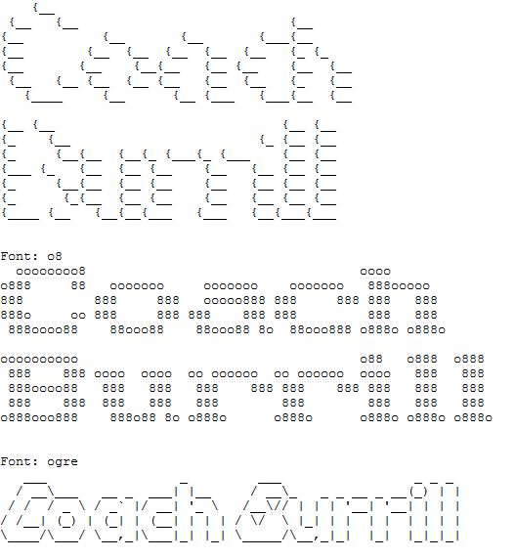
Websites- ASCII Art Generators
ASCII Art Word Generator

Slide 22

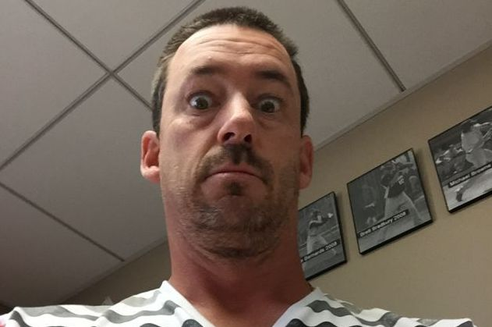
Websites- ASCII Art Generators
Picture to ASCII Art

Slide 23
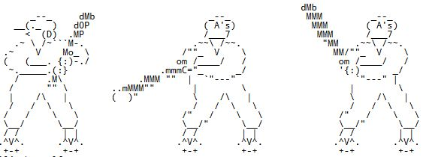
Review
Binary – Text
Binary – Hexadecimal
Hexadecimal-Text
Decimal-Hexadecimal
ASCII Art
Journal Check End of the Week
Unit 1- Lesson 1-6 Review Quiz- May Use Your Journal

